Slide 1

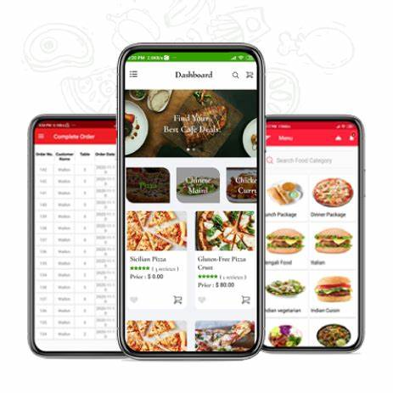
ZOMATO DASHBOARD
BATCH N0.16
227R1A05F7
227R1A05J3
227R1A05J0

Slide 2
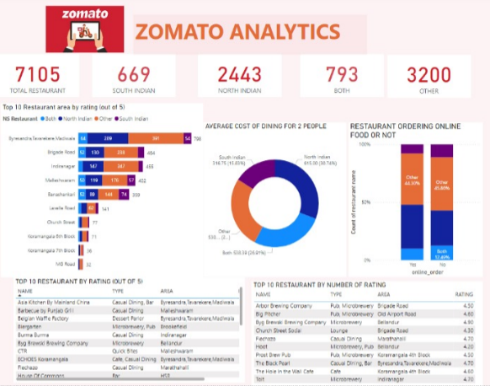
INTRODUCTION
Zomato Dashboard in Power BI provides comprehensive analytics and visualization of restaurant data.
Users can track key metrics such as sales, customer feedback, and trends in a user-friendly interface.
The dashboard helps restaurant owners make data-driven decisions to improve their business performance.
Notes:
Image source: https://dribbble.com/shots/13233468-Zomato-Dashboard-Design

Slide 3

KEY FEATURES
Real-time data updates ensure that restaurant owners have access to the latest information.
Interactive visualizations allow users to drill down into specific data points for deeper insights.
Customizable dashboards enable users to tailor the view to their specific needs and preferences.
Notes:
Image source: https://www.indifi.com/blog/using-zomato-dashboard-for-better-data-organization/

Slide 4
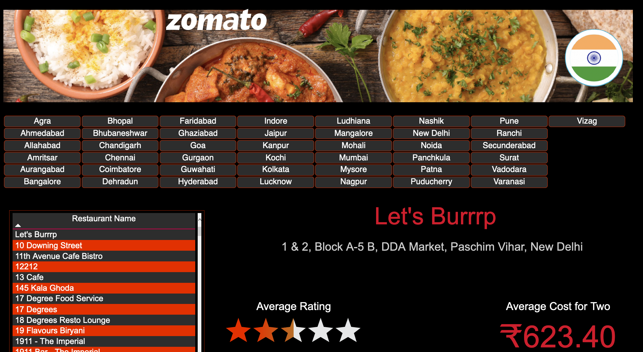
BENEFITS
Increased efficiency in monitoring and analyzing restaurant performance metrics.
Improved decision-making based on actionable insights derived from data.
Enhanced visibility into customer preferences and behaviors to drive business growth.
Notes:
Image source: https://community.powerbi.com/t5/Data-Stories-Gallery/Zomato-India/m-p/1629985

Slide 5
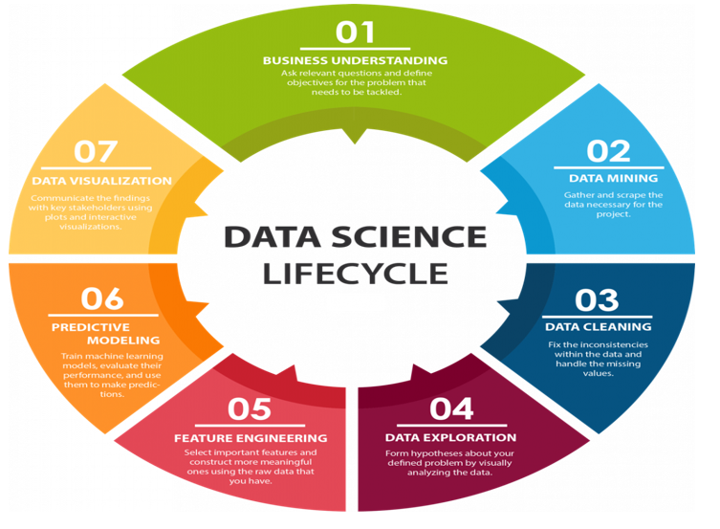
DATA SOURCES AND INTEGRATION
Zomato Dashboard integrates data from various sources such as sales transactions, customer reviews, and operational metrics.
Seamless integration with Power BI allows for easy access to external data sources for comprehensive analysis.
Data cleansing and transformation processes ensure data accuracy and consistency in the dashboard.
Notes:
Image source: https://dribbble.com/shots/13233468-Zomato-Dashboard-Design

Slide 6
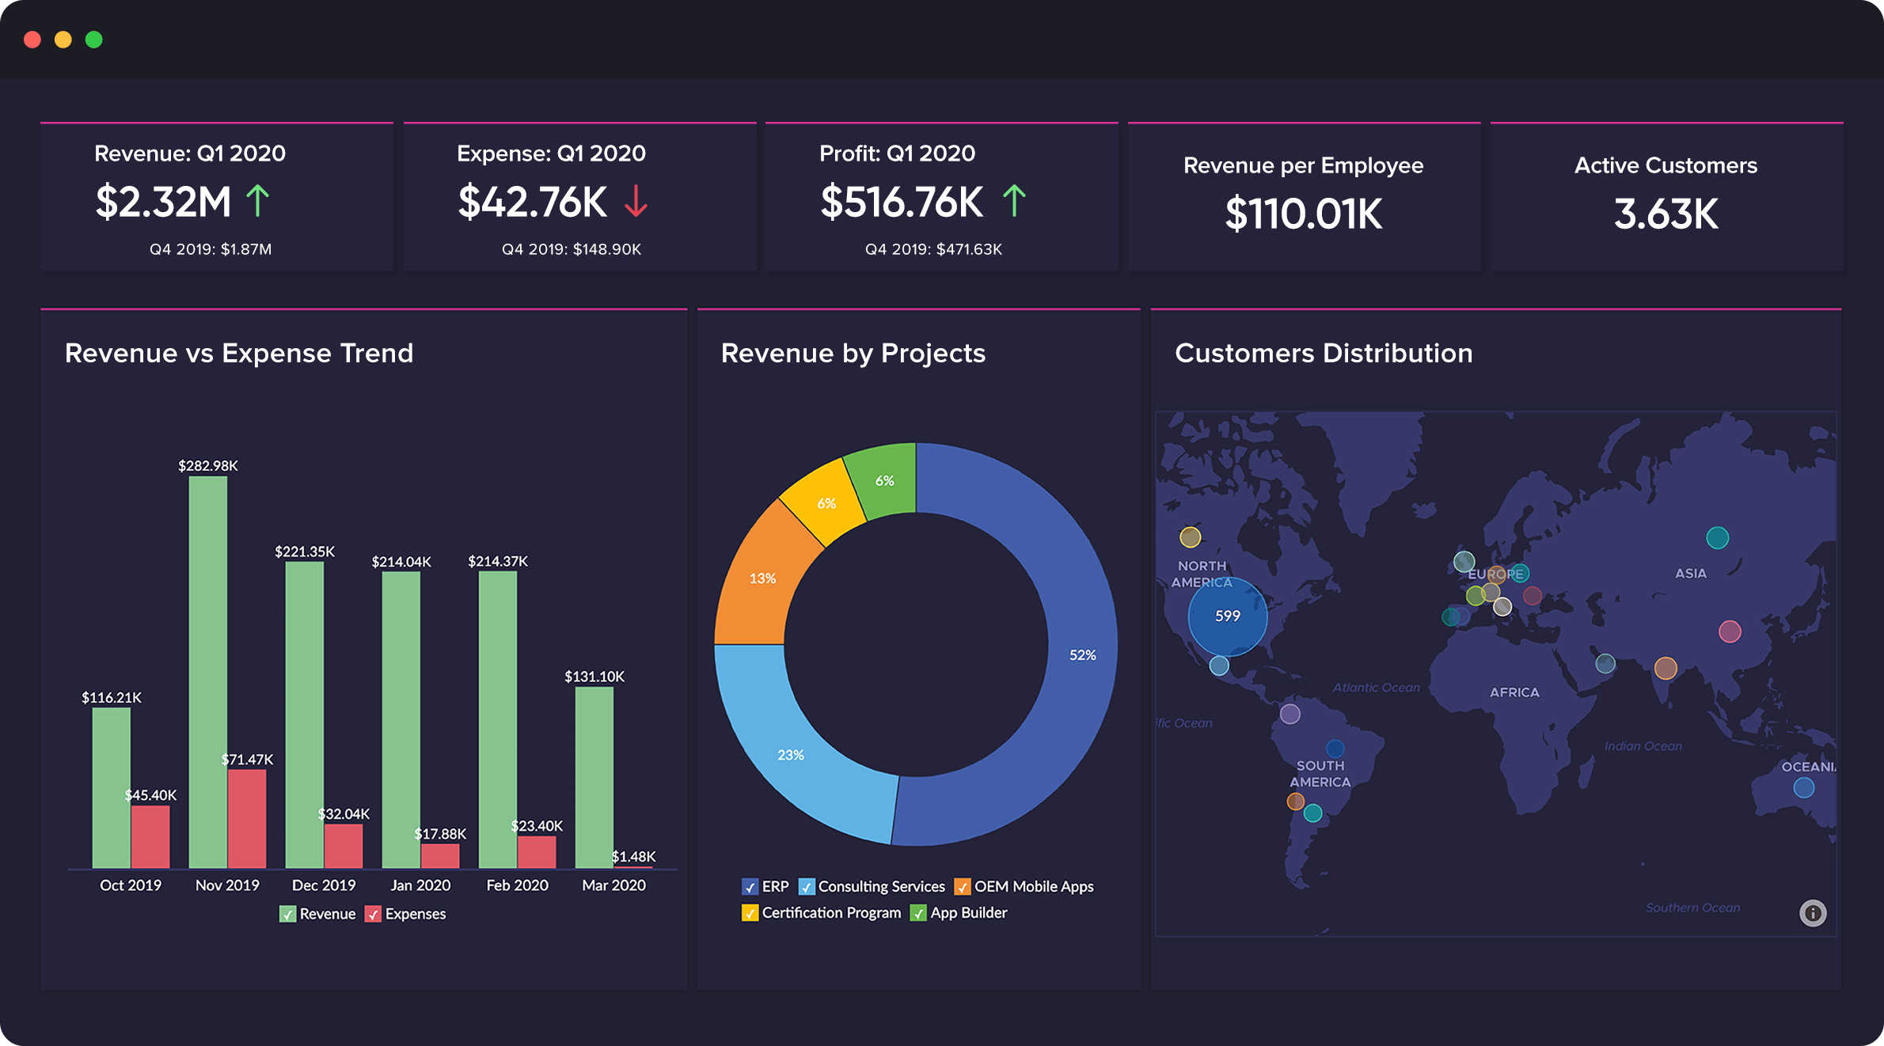
VISUALIZATION TOOLS
Power BI offers a wide range of visualization tools such as charts, graphs, and maps to present data in a visually appealing manner.
Advanced analytics features enable users to perform complex calculations and forecasting within the dashboard.
Dynamic filters and slicers allow users to interact with the data and customize their view based on specific criteria.
Notes:
Image source: https://www.zoho.com/crm/enterprise/solutions/business-intelligence.html

Slide 7

CASE STUDIES: SUCCESSFUL IMPLEMENTATION OF ZOMATO DASHBOARD
Several restaurants have reported significant improvements in sales and customer satisfaction after implementing Zomato Dashboard.
The ability to identify and address operational inefficiencies has led to cost savings and increased profitability for many businesses.
Positive feedback from users highlights the impact of data-driven decision-making on business outcomes.
Notes:
Image source: https://yesnearme.com/news/case-study-of-zomato/

Slide 8
USER EXPERIENCE AND INTERFACE DESIGN
The user-friendly interface of Zomato Dashboard ensures a seamless and intuitive user experience.
Customizable layouts and dashboards cater to the diverse needs of different users within the organization.
Accessibility features such as mobile responsiveness make it easy for users to access the dashboard on the go.
Notes:
Image source: https://dribbble.com/shots/13233468-Zomato-Dashboard-Design

Slide 9
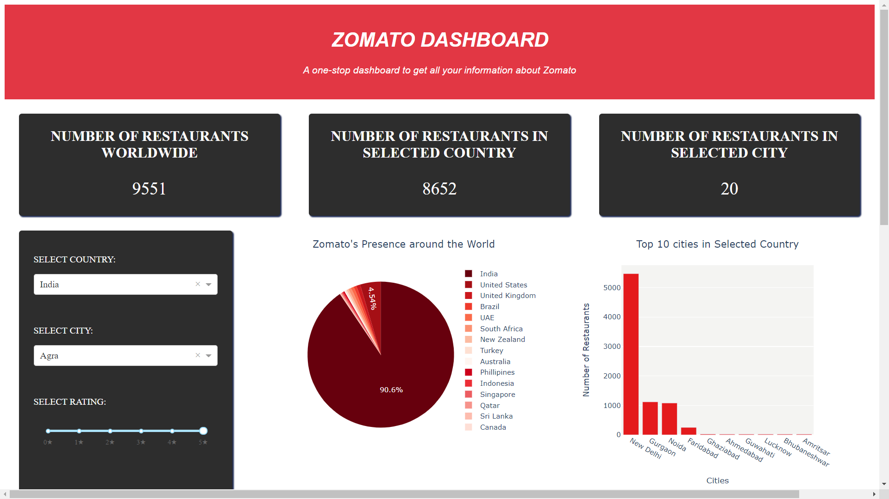
SECURITY AND DATA PRIVACY
Zomato Dashboard adheres to strict security protocols to protect sensitive data and ensure compliance with privacy regulations.
Role-based access control allows administrators to manage user permissions and restrict access to sensitive information.
Data encryption and secure connections safeguard data integrity and confidentiality within the dashboard.
Notes:
Image source: https://github.com/meghna1212/Zomato-Dashboard-using-Dash-and-Plotly

Slide 10
CONCLUSION AND FUTURE OUTLOOK
Zomato Dashboard in Power BI is a powerful tool for restaurant owners to gain valuable insights and drive business growth.
Continued enhancements and updates to the dashboard will further improve its functionality and usability.
Embracing data analytics and visualization tools like Zomato Dashboard is essential for staying competitive in the restaurant industry.
Notes:
Image source: https://dribbble.com/shots/13233468-Zomato-Dashboard-Design

Slide 11


